Slide 1
CS4104
Applied Machine Learning
Lecture No 3
Inductive Learning
(Decision Trees)
Spring 2025
1

Slide 2
DECISION TREES
Introduction
It is a method that induces concepts from examples
(inductive learning)
Most widely used & practical learning method
The learning is supervised : i.e. the classes or categories of the
data instances are known
It represents concepts as decision trees (which can be
rewritten as if-then rules)
2

Slide 3
DECISION TREES
Introduction
The target function can be Boolean or discrete valued
3

Slide 4
DECISION TREES
Decision Tree Representation
1. Each node corresponds to an attribute
2. Each branch corresponds to an attribute value
3. Each leaf node assigns a classification
4

Slide 5
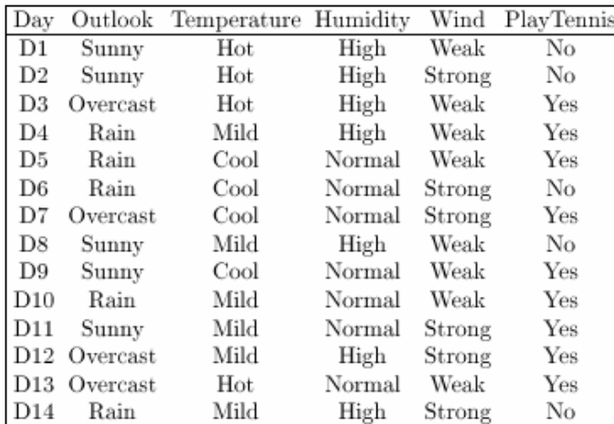
DECISION TREES
Example
5

Slide 6





DECISION TREES
Outlook
Example
Sunny
Humidity
Rain
Wind
Overcast
High
Normal
Strong
Weak
A Decision Tree for the concept PlayTennis
An unknown observation is classified by testing its attributes
and reaching a leaf node
6

Slide 7
DECISION TREES
Example
7

Slide 8
DECISION TREES
Outlook
Example
Sunny
Humidity
Rain
Wind
Overcast
High
Normal
Strong
Weak
A Decision Tree for the concept PlayTennis
An unknown observation is classified by testing its attributes
and reaching a leaf node
8

Slide 9
DECISION TREES
Decision Tree Representation
Decision trees represent a disjunction of conjunctions of
constraints on the attribute values of instances
Each path from the tree root to a leaf corresponds to a
conjunction of attribute tests (one rule for classification)
The tree itself corresponds to a disjunction of these
conjunctions (set of rules for classification)
9

Slide 10
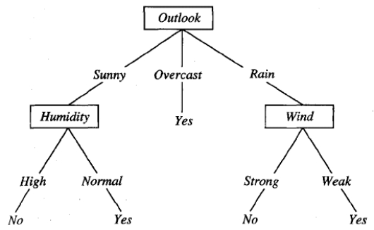
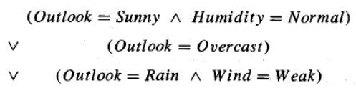
DECISION TREES
Decision Tree Representation
10

Slide 11
DECISION TREES
Basic Decision Tree Learning Algorithm
11

Slide 12
DECISION TREES
Basic Decision Tree Learning Algorithm
Most algorithms for growing decision trees are variants of a
basic algorithm
An example of this core algorithm is the ID3 (Iterative Dichotomiser 3)
Algorithm developed by Quinlan.
It employs a top-down, greedy search through the space of
possible decision trees
12
Notes:
In decision tree learning, ID3 (Iterative Dichotomiser 3) is an algorithm invented by Ross Quinlan^{[1]} used to generate a decision tree from a dataset. ID3 is the precursor to the C4.5 algorithm, and is typically used in the machine learning and natural language processing domains.

Slide 13
DECISION TREES
Basic Decision Tree Learning Algorithm
First of all we select the best attribute to be tested at the root
of the tree
For making this selection each attribute is evaluated using a
statistical test to determine how well it alone classifies the
training examples
13

Slide 14
DECISION TREES
Basic Decision Tree Learning Algorithm
We have
D12
D11
D1
- 14 observations
D2
D5
D10
D4
- 4 attributes
D6
• Outlook
• Temperature
D3
D14
D8
D9
• Humidity
• Wind
D7
D13
- 2 classes (Yes, No)
14

Slide 15
DECISION TREES
Basic Decision Tree Learning Algorithm
Outlook
Sunny
Rain
Overcast
D1
D9
D8
D11
D10
D14
D5
D6
D3
D7
D4
D12
D13
D2
15

Slide 16
DECISION TREES
Basic Decision Tree Learning Algorithm
The selection process is then repeated using the training
examples associated with each descendant node to select the
best attribute to test at that point in the tree
16

Slide 17

DECISION TREES
Rain
Overcast
Outlook
Sunny
D1
D9
D8
D10
D14
D5
D6
D3
D7
D11
D4
D12
D13
D2
What is the
“best” attribute to test at this point? The possible choices are
Temperature, Wind & Humidity
17

Slide 18
DECISION TREES
Basic Decision Tree Learning Algorithm
This forms a greedy search for an acceptable decision tree, in
which the algorithm never backtracks to reconsider earlier
choices
18

Slide 19
DECISION TREES
Which Attribute is the Best Classifier?
19

Slide 20
DECISION TREES
Which Attribute is the Best Classifier?
The central choice in the ID3 algorithm is selecting which
attribute to test at each node in the tree
We would like to select the attribute which is most useful for
classifying examples
For this we need a good quantitative measure
For this purpose a statistical property, called information
gain is used
20

Slide 21
DECISION TREES
Which Attribute is the Best Classifier?: Definition of Entropy
In order to define information gain precisely, we begin by
defining entropy
Entropy is a measure commonly used in information theory.
Entropy characterizes the impurity of an arbitrary collection
of examples
21

Slide 22
DECISION TREES
Which Attribute is the Best Classifier?: Definition of Entropy
Suppose we have four independent values of a variable X:
A, B, C, D
These values are independent and occur randomly
You might transmit these values over a binary serial link by
encoding each reading with two bits
A = 00
B = 01
C = 10
D = 11
We might see something like this: 0100001001001110110011
22

Slide 23
DECISION TREES
Which Attribute is the Best Classifier?: Definition of Entropy
Someone tells you that there probabilities of occurrence is
not equal:
p(A) = 1/2
p(B) = 1/4
p(C) = 1/8
p(D) = 1/8
It is now possible to invent a coding that only uses 1.75 bits
on average per symbol, for the transmission, e.g.
A=0
B = 10
C = 110
D = 111
23

Slide 24

DECISION TREES
Which Attribute is the Best Classifier?: Definition of Entropy
Suppose X can have m values, V 1 , V 2 , …, V m , with
probabilities: p 1 , p 2 , …, p m
The smallest number of bits, on average, per value, needed to
transmit a stream of values of X is
The negative sign is to make the whole quantity positive
(because log 2 of fractions is a negative value)
24

Slide 25
DECISION TREES
Which Attribute is the Best Classifier?: Definition of Entropy
If a p = 1 and all other p’s are 0, then we need 0 bits (i.e. we
don’t need to transmit anything)
If all p’s are equal for a given m , we need the highest number
of bits for transmission
If there are m possible values of an attribute, then the
entropy can be as large as log 2 m
25

Slide 26
DECISION TREES
Which Attribute is the Best Classifier?: Definition of Entropy
This formula is called Entropy H
H(X) =
High Entropy means that the examples have almost equal
probability of occurrence (and therefore not easily
predictable)
Low Entropy means easy predictability
26
Notes:
As mentioned at the end of the above section, the binary logarithm is a special case of the logarithmic function with base 2. That means that we'll have expressions of the form log₂(x), and we'll ask ourselves to what power we should raise 2 in order to obtain x. For instance, we can easily observe that log₂ 4 = 2.
Seemingly, 2 is a number like any other. However, it has some interesting properties. E.g., it is the smallest prime number and the only even one. Moreover, it's the base for any computer-related operations via the binary representation.
Since it's so important, let's recall a few basic powers of 2. Remember that the exponent can also be 0 or even negative.
x
-3
-2
-1
0
1
2
3
4
5
6
7
8
2^{x}
⅛
¼
½
1
2
4
8
16
32
64
128
256
Now we can see some more examples than just the log₂ 4 = 2 from above. For instance, we can say that the log with base 2 of 8 is 3. Similarly, log₂ 16 = 4 or log₂ 32 = 5.

Slide 27
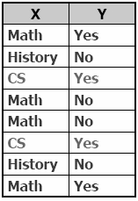
DECISION TREES
Which Attribute is the Best Classifier?: Information Gain
Suppose we are trying to predict output Y (Like Film
Gladiator) & we have input X (College Major = v)
Major
Math
CS
History
27

Slide 28
DECISION TREES
Which Attribute is the Best Classifier?: Information Gain
We have
H(Y) = 1.0
Conditional Entropy H(Y | X = v)
The Entropy of Y among only those records in which X = v
Major
Math
CS
History
28

Slide 29
DECISION TREES
Which Attribute is the Best Classifier?: Information Gain
Conditional Entropy of Y
H(Y | X = Math) = 1.0
H(Y | X = History) = 0
H(Y | X = CS) = 0
Major
Math
CS
History
29

Slide 30

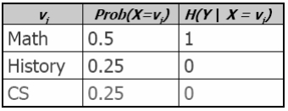
DECISION TREES
Which Attribute is the Best Classifier?: Information Gain
Average Conditional Entropy of Y
H(Y | X) =
Major
Math
CS
History
30
Notes:
2/8 = 0.25

Slide 31
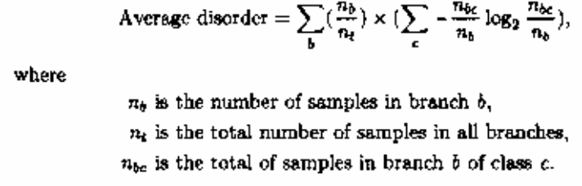

DECISION TREES
Which Attribute is the Best Classifier?: Information Gain
Make decision tree by selecting tests with minimum entropy
(also called disorder)
31

Slide 32
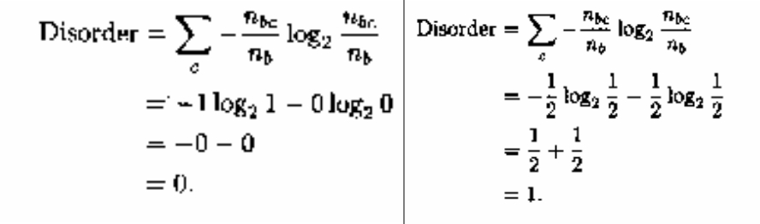
DECISION TREES
Which Attribute is the Best Classifier?: Information Gain
32

Slide 33
DECISION TREES
Which Attribute is the Best Classifier?: Information Gain
The formula can be converted from log 2 to log 10
log x (M)
= log 10 M . log x 10
= log 10 M/log 10 x
Hence log 2 (M) = log 10 (M)/log 10 (2) = 3.322 log 10 (M)
33

Slide 34
DECISION TREES
Which Attribute is the Best Classifier?: Information Gain
Information Gain is the expected reduction in entropy
caused by partitioning the examples according to an
attribute’s value
Info Gain (Y | X) = H(Y) – H(Y | X) = 1.0 – 0.5 = 0.5
For transmitting Y, how much bits would be saved if both
side of the line knew X
In general, we write Gain (S, A)
Where S is the collection of examples & A is an attribute
34

Slide 35
DECISION TREES
Which Attribute is the Best Classifier?: Information Gain
Let’s
investigate
the attribute
Wind
35

Slide 36

DECISION TREES
Which Attribute is the Best Classifier?: Information Gain
The collection of examples has 9 positive values and 5
negative ones
Eight (6 positive and 2 negative ones) of these examples
have the attribute value Wind = Weak
Six (3 positive and 3 negative ones) of these examples have
the attribute value Wind = Strong
36

Slide 37
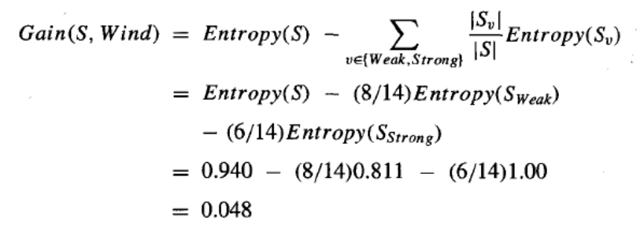
DECISION TREES
Which Attribute is the Best Classifier?: Information Gain
The information gain obtained by separating the
examples according to the attribute Wind is calculated as:
37

Slide 38
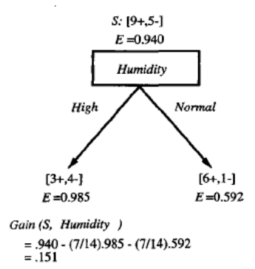
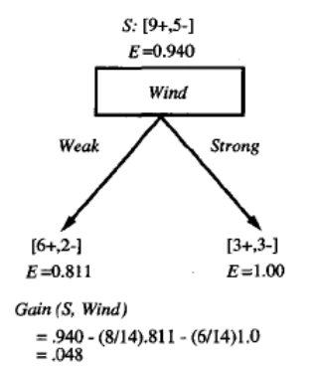
DECISION TREES
Which Attribute is the Best Classifier?: Information Gain
We calculate the Info Gain for each attribute and select
the attribute having the highest Info Gain
38

Slide 39
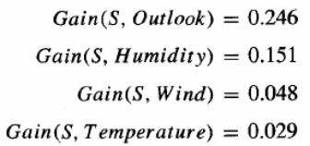
DECISION TREES
Example
Which attribute should be selected as the first test?
“Outlook” provides the most information
39

Slide 40
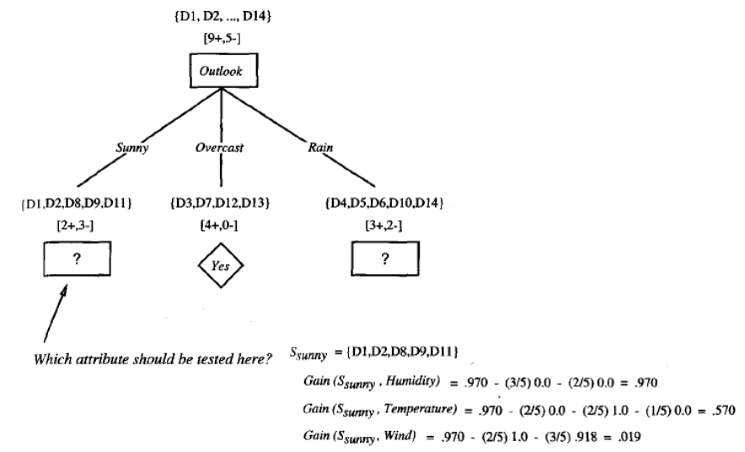
DECISION TREES
40

Slide 41
DECISION TREES
Example
The process of selecting a new attribute is now repeated for
each (non-terminal) descendant node, this time using only
training examples associated with that node
Attributes that have been incorporated higher in the tree are
excluded, so that any given attribute can appear at most once
along any path through the tree
41

Slide 42
DECISION TREES
Example
This process continues for each new leaf node until either:
1. Every attribute has already been included along this path
through the tree
2. The training examples associated with a leaf node have
zero entropy
42

Slide 43

DECISION TREES
Example
43

Slide 44
DECISION TREES
From Decision Trees to Rules
Next Step: Make rules from the decision tree
After making the decision tree, we trace each path from the
root node to leaf node, recording the test outcomes as
antecedents and the leaf node classification as the consequent
For our example we have:
If the Outlook is Sunny and the Humidity is High then No
If the Outlook is Sunny and the Humidity is Normal then Yes
...
44

Slide 45
DECISION TREES
Example
45

Slide 46
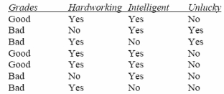
DECISION TREES
Example
Grades
Good
Bad
Bad
Good
Good
Bad
Bad
Hardworking
Yes
No
Yes
Yes
Yes
No
Yes
Intelligent
Yes
Yes
No
Yes
Yes
Yes
No
Unlucky
No
Yes
Yes
No
No
No
No
1.
2.
3.
4.
5.
6.
7.
46

Slide 47
DECISION TREES
Example
Show the steps of decision tree induction algorithm for
the data
The concepts to be learnt are Grades (Grades are class
labels)
If two or more attributes have similar Information
Gain, pick any of them.
Since the best entropy is zero, hence if the average
entropy of an attribute is zero, there is no need to
check other candidate attributes.
47

Slide 48
DECISION TREES
Example
The entropy of the data:
There are 3 samples of Good Grades and 4 samples of Bad
Grades.
Hence the entropy the data is
- (3/7) log 2 (3/7) - (4/7) log 2 (4/7)
= 0.524 + 0.461
= 0.985
48

Slide 49
DECISION TREES
Example
First we calculate which of the three attributes will be best for
the root node.
There are three attributes:
Hardworking, Intelligent, Unlucky
49

Slide 50
DECISION TREES
Example
Attribute “Hardworking”
Branch Hardworking = Yes (5 samples fulfill this condition)
Branch Hardworking = No (2 samples fulfill this condition)
50

Slide 51
DECISION TREES
Example
Attribute “Hardworking”
Branch Hardworking = Yes (5 samples fulfill this condition)
There are
3 samples of Good Grades and
2 samples of Bad Grades.
Entropy of this branch =
- (3/5) log 2 (3/5) - (2/5) log 2 (2/5)}
= 0.442 + 0.53
= 0.972
51

Slide 52
DECISION TREES
Example
Attribute “Hardworking”
Branch Hardworking = No (2 samples fulfill this condition)
Both of these 2 samples are of Bad Grades
Entropy of this branch =
- (0/2) log2 (0/2) - (2/2) log2 (2/2) = 0
52

Slide 53
DECISION TREES
Example
Average Entropy of Attribute “Hardworking” =
5/7 * 0.972 + 2/7 * 0 = 0.694
Information Gain of Attribute “Hardworking” =
0.985 – 0.694 = 0.291
53

Slide 54
DECISION TREES
Example
Similarly we calculate the average entropy and information
gain of the attributes “Intelligent” and “Unlucky”
We need not calculate these values fully because both of the
attributes have
two branches
one branch has 5 & the other one has 2 samples
The branch with 5 samples has 3 samples of a certain
class label and 2 samples of another class label
The branch with 2 samples has homogenous class labels
54

Slide 55
DECISION TREES
Example
Anyway after calculation (or after inference due to symmetry)
we find that the information gain of all three attributes is
similar
Hence we can place any attribute at the root node
Arbitrarily we choose “Hardworking”
55

Slide 56

DECISION TREES
Example
“Hardworking”
Yes
Good Grades
Good Grades
No
Bad Grades
Bad Grades
Good Grades
Bad Grades
Bad Grades
Since 2 nd branch has samples of homogenous class labels hence
we do not expand it further
56

Slide 57
DECISION TREES
Example
“Hardworking”
No
Bad
Grades
Yes
?
57

Slide 58
DECISION TREES
Example
The branch “Hardworking” = Yes has to be grown
We test the two remaining attributes “Intelligent” and
“Unlucky”
First we note the Entropy of the branch “Hardworking” = Yes
for the purpose of Information Gain
There are a total of 5 samples: 3 samples of Good
Grades and 2 samples of Bad Grades
Entropy is
- (3/5) log2 (3/5) - (2/5) log2 (2/5)
= 0.442 + 0.53 = 0.972
58

Slide 59
DECISION TREES
Example
Attribute “Intelligent”
Branch Intelligent = Yes (3 samples fulfill this condition)
All the 3 samples are of Good Grades.
Hence Entropy = 0
Branch Intelligent = No (2 samples fulfill this condition)
Both of these 2 samples are of Bad Grades.
Hence Entropy = 0
59

Slide 60
DECISION TREES
Example
Attribute “Intelligent”
Average Entropy of Attribute “Intelligent”
= 3/5 * 0 + 2/5 * 0 = 0
Information Gain of Attribute “Intelligent”
= 0.972 – 0 = 0.972
Since we cannot have better results, therefore there is no need
to test the other attribute “Unlucky”.
60

Slide 61

DECISION TREES
Example
“Hardworking”
Yes
Intelligent
No
Bad
Grades
Yes
No
Good
Grades
Bad
Grades
61

Slide 62
DECISION TREES
Reference
Sections 3.1 – 3.4
Section 4.3
of T. Mitchell
of Witten & Frank
62

